Slide 1
Coding for Site Response Analysis of a Layered Soil Column (Total Stress Analysis) in opensees
By jubin kumar soni

Slide 2
DEFINE ANALYSIS PARAMETERS
set soilThick 40.0(in m)
set rho 1.7(Mg/m^3)(megagram/metrecube)
set Vs 250.0(m/sec)
set G [expr $rho*$Vs*$Vs](in Kpa)
set nu 0.0(poisson ratio of soil)
set E [expr 2*$G*(1+$nu)](Kpa)
set bulk [expr $E/(3*(1-2*$nu))](Kpa)
set cohesion 95.0(Kpa)
set gammaPeak 0.05(peak shear strian)
set phi 0.0(friction angle)
set rockVS 760(in m/sec)
set rockDen 2.4(Mg/m^3)

Slide 3
set motionDT 0.005(time step)
set motionSteps 7990(no of steps)
set fMax 100.0
set wave [expr $Vs/$fMax](wavelength of highest freq to be resolved)
set nEle 10(no of elements per wavelength)
set pi 3.141592654
set damp 0.02(damping ratio)
# Laboratory measurements show the freq bandwidth to be between 0.2 and 20 kHz
set omega1 [expr 2*$pi*0.2]
set omega2 [expr 2*$pi*20]
set a0 [expr 2*$damp*$omega1*$omega2/($omega1 + $omega2)]
set a1 [expr 2*$damp/($omega1 + $omega2)]
#newmark parameters(Avg.accln method)
set gamma 0.5
set beta 0.25

Slide 4
DEFINE MESH GEOMETRY
set hTrial [expr $wave/$nEle]
set nTrial [expr $soilThick/$hTrial]
#to round up no of elements
if { $nTrial > [expr floor($soilThick/$hTrial)] } {
set numEleY [expr int(floor($soilThick/$hTrial)+1)]
} else {
set numEleY [expr int($nTrial)]
}
set sizeEleY [expr $soilThick/$numEleY](vertical size of element)
set sizeEleX $sizeEleY(horizontal size of element)
#considering square mesh
set numNodeY [expr 2*($numEleY + 1)](number of nodes in y dirn)

Slide 5
DEFINE NODES FOR SOIL ELEMENTS
model BasicBuilder -ndm 2 -ndf 2
set yCoord 0.0
set count 0
# loop over nodes
for {set j 1} {$j <= $numNodeY} {incr j 2} {
node $j 0.0 [expr $yCoord + $count*$sizeEleY]
node [expr $j+1] $sizeEleX [expr $yCoord + $count*$sizeEleY]
set count [expr $count+1]
}

Slide 6
DEFINE DASHPOT NODES
node 2000 0.0 0.0
node 2001 0.0 0.0

Slide 7
DEFINE BOUNDARY CONDITIONS AND EQUAL DOF
fix 1 0 1
fix 2 0 1
fix 2000 1 1
fix 2001 0 1
for {set k 3} {$k <= $numNodeY} {incr k 2} {
equalDOF $k [expr $k+1] 1 2
}
equalDOF 1 2 1
equalDOF 1 2001 1

Slide 8
DEFINE SOIL ELEMENTS
set wgtX 0.0
set wgtY [expr -9.81*$rho]
for {set j 1} {$j <= $numEleY} {incr j 1} {
set nI [expr 2*$j - 1]
set nJ [expr $nI + 1]
set nK [expr $nI + 3]
set nL [expr $nI + 2]
element quad $j $nI $nJ $nK $nL 1.0 "PlaneStrain" 1 0.0 0.0 $wgtX $wgtY
}

Slide 9
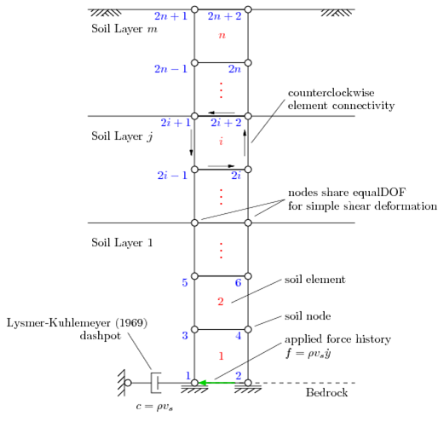
Schematic representation of the site response model. Node numbers in blue, element numbers in red.

Slide 10
CREATE GRAVITY RECORDERS
# record nodal displacments, velocities, and accelerations at each time step
recorder Node -file Gdisplacement.out -time -nodeRange 1 $numNodeY -dof 1 2 disp
recorder Node -file Gvelocity.out -time -nodeRange 1 $numNodeY -dof 1 2 vel
recorder Node -file Gacceleration.out -time -nodeRange 1 $numNodeY -dof 1 2 accel
# record stress and strain at each gauss point in the soil elements
recorder Element -file Gstress1.out -time -eleRange 1 $numEleY material 1 stress
recorder Element -file Gstress2.out -time -eleRange 1 $numEleY material 2 stress
recorder Element -file Gstress3.out -time -eleRange 1 $numEleY material 3 stress
recorder Element -file Gstress4.out -time -eleRange 1 $numEleY material 4 stress
recorder Element -file Gstrain1.out -time -eleRange 1 $numEleY material 1 strain
recorder Element -file Gstrain2.out -time -eleRange 1 $numEleY material 2 strain
recorder Element -file Gstrain3.out -time -eleRange 1 $numEleY material 3 strain
recorder Element -file Gstrain4.out -time -eleRange 1 $numEleY material 4 strain

Slide 11
CREATE POST-GRAVITY RECORDERS
recorder Node -file displacement.out -time -dT $motionDT -nodeRange 1 $numNodeY -dof 1 2 disp
recorder Node -file velocity.out -time -dT $motionDT -nodeRange 1 $numNodeY -dof 1 2 vel
recorder Node -file acceleration.out -time -dT $motionDT -nodeRange 1 $numNodeY -dof 1 2 accel
recorder Element -file stress1.out -time -dT $motionDT -eleRange 1 $numEleY material 1 stress
recorder Element -file stress2.out -time -dT $motionDT -eleRange 1 $numEleY material 2 stress
recorder Element -file stress3.out -time -dT $motionDT -eleRange 1 $numEleY material 3 stress
recorder Element -file stress4.out -time -dT $motionDT -eleRange 1 $numEleY material 4 stress
recorder Element -file strain1.out -time -dT $motionDT -eleRange 1 $numEleY material 1 strain
recorder Element -file strain2.out -time -dT $motionDT -eleRange 1 $numEleY material 2 strain
recorder Element -file strain3.out -time -dT $motionDT -eleRange 1 $numEleY material 3 strain
recorder Element -file strain4.out -time -dT $motionDT -eleRange 1 $numEleY material 4 strain

Slide 12
algorithim
constraints Transformation
test NormDispIncr 1.e-6 15 1
algorithm Newton
numberer RCM
#symmmetric postive definite SOE
system ProfileSPD
integrator Newmark $gamma $beta
rayleigh $a0 $a1 0.0 0.0
analysis Transient

